Slide 1
A Place for Us All PRESENTATION TEMPLATE
DRCOG Regional Housing Strategy / Tools for Talking About Housing
NOTE TO USER: DELETE THIS SLIDE FROM YOUR FINAL PRESENTATION
Purpose and Use
Use the following slides to talk about the Regional Housing Strategy (RHS) and the types of actions that might work in in your community.
The five areas of focus for "What can we do?" reflect the five RHS pathways but use more concise and accessible language for a general audience.
The slides are intended for a general audience but can be customized for your specific group. You can cut, paste and delete to use only those slides that meet your needs.
Integrate with engagement activities to understand community perspectives and priorities. Refer to the ”Let’s Talk Housing" Messaging Playbook for ideas.
Suggested talking points for each slide are provided in the notes for each slide along with links to additional information where relevant.
Customize the slides to reflect local community context, strategies, and/or priorities.
Notes:
Slides 1 and 2 explain the purpose of using this presentation and instructions for customizing the template. Make sure to delete these slides from your final presentation!

Slide 2
A Place for Us All PRESENTATION TEMPLATE continued
DRCOG Regional Housing Strategy / Tools for Talking About Housing
NOTE TO USER: DELETE THIS SLIDE FROM YOUR FINAL PRESENTATION
Customizing the Template
ADD your jurisdiction or organization name and logo to the title slide along with info about the time/date of your presentation.
DELETE this and the previous slide as well as any other slides that are not pertinent to your audience or your jurisdiction.
MODIFY specific terms, photos, and content to reflect your jurisdiction’s, organization’s or audience’s perspectives and priorities. Replace the photos with images of places, people and housing that will resonate with your audience.
  To change photos: right click on the image you want to change and select “Change picture.”
  To adjust image size: right click and choose “Crop.”
ADD slides that provide more information about local strategies and priorities to address the housing challenges specific to your community.

Slide 3
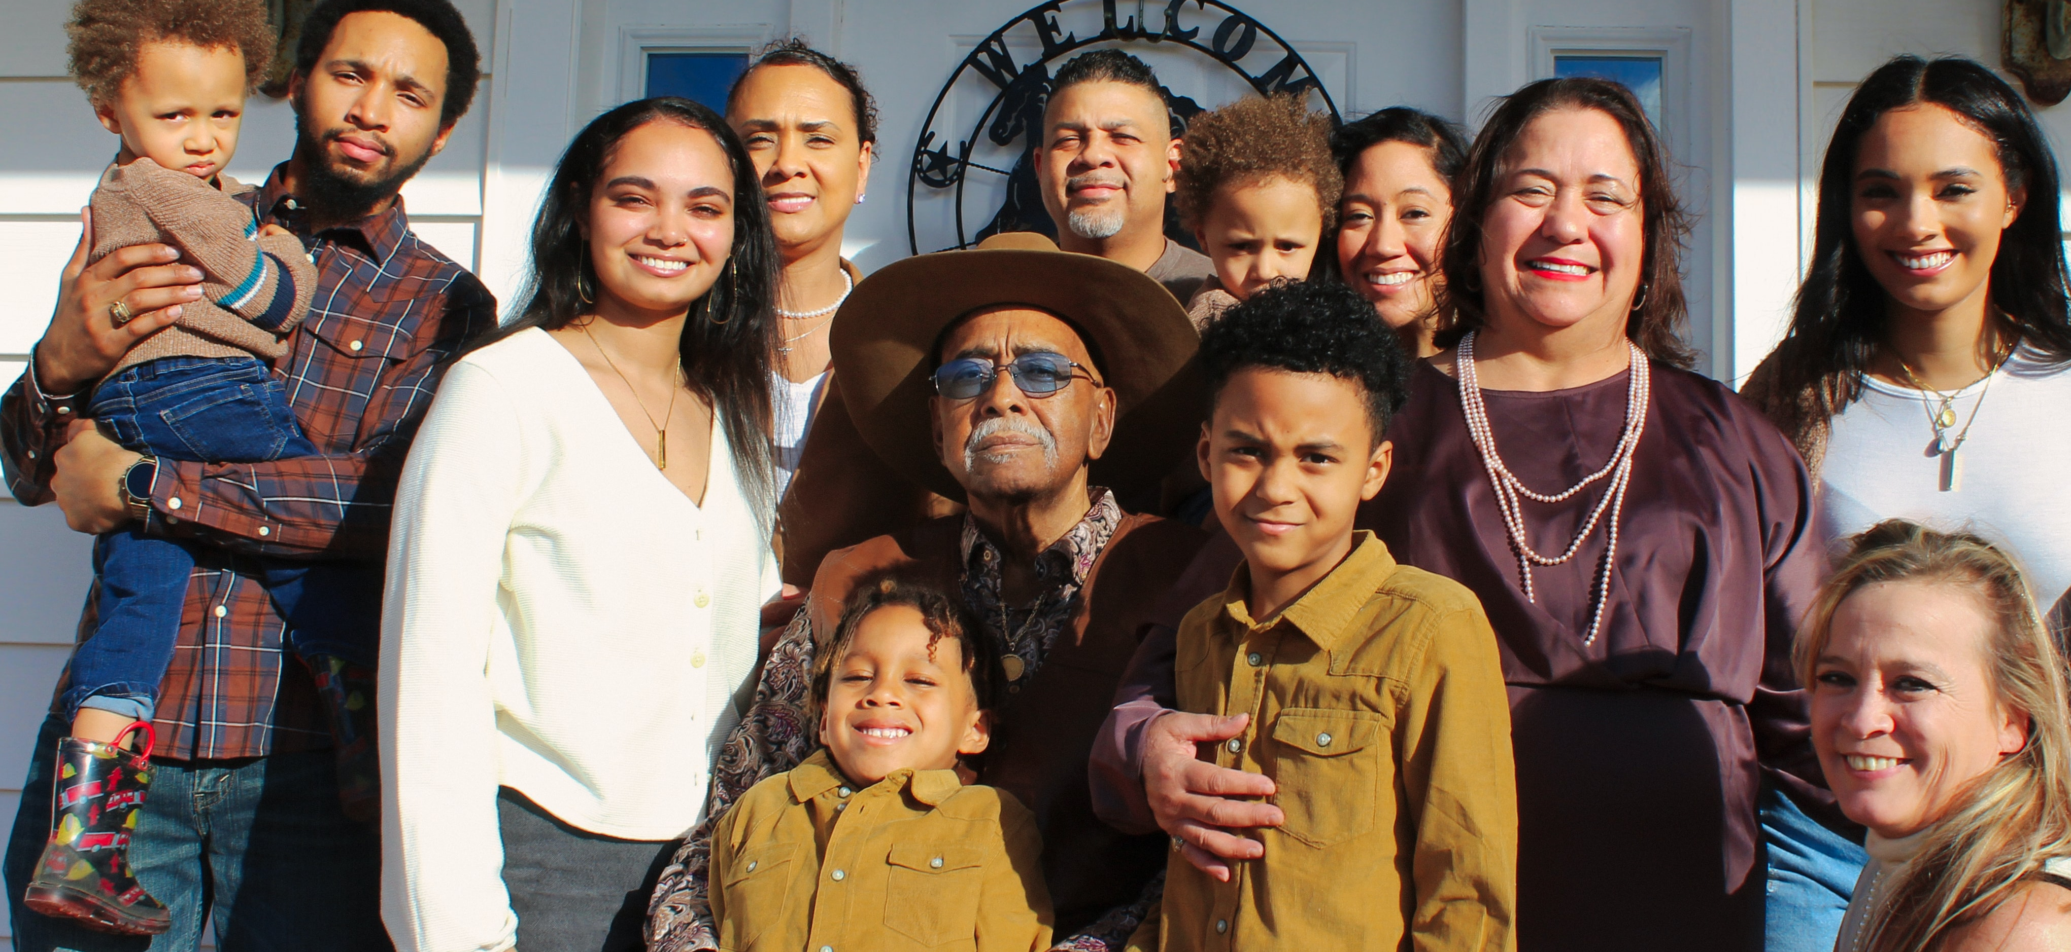
A Place for Us All
Housing for Our Growing Region
Meeting Name / Date / Time
Update with local seal/logo or remove
Notes:
Use this slide to welcome participants, explain the purpose of the presentation, and set expectations for what will be covered. Keep it high-level and conversational.

Slide 4
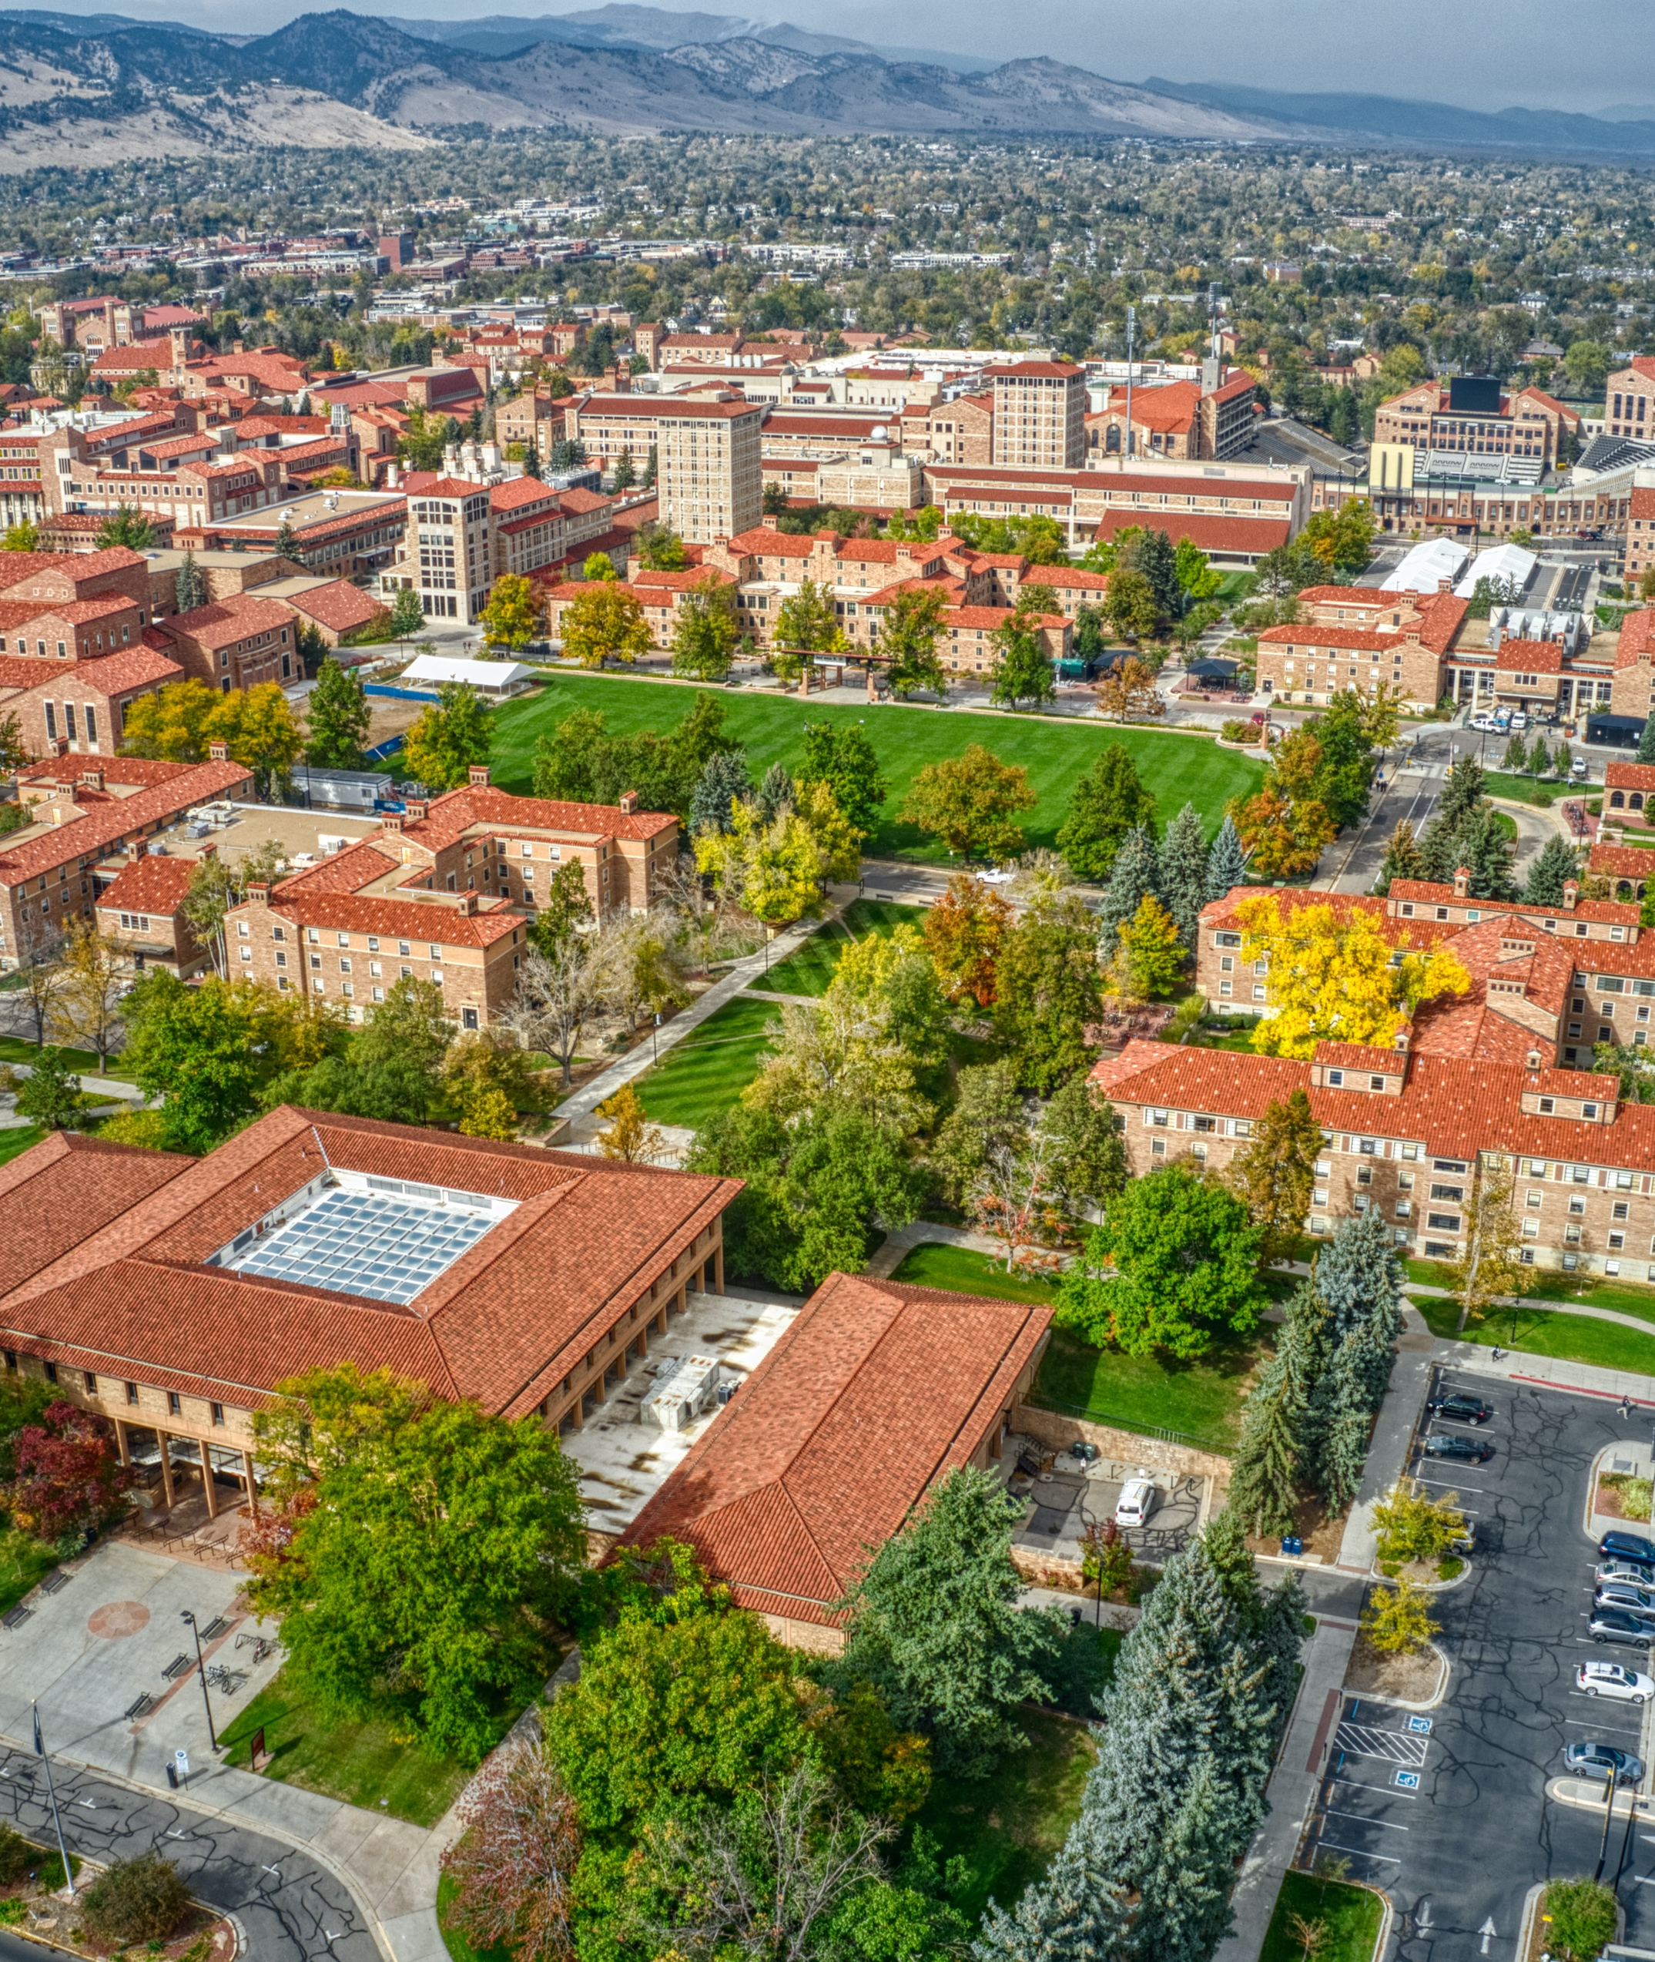
Our Region Is Growing
We are growing jobs,
growing our communities,
and growing our families
To meet current needs and projected growth, we will need more than 200,000 new homes in the next ten years, and more than 500,000 new homes by 2050.
Notes:
This slide ties our region’s need for housing to growth in the region. Replace the image with a photo of local housing or leave it as is. Consider adding or referencing more localized projections of growth and how that relates to regional growth.

Slide 5

Our Needs Are Changing
We are growing older
Our climate is changing
There is more traffic
Homes cost more than many people can afford
As we grow, we need to preserve older homes plus create different types of new homes, in the right locations, at prices people can afford.
Notes:
This slide emphasizes that our housing development must respond to demographic and environmental changes in the region. Use this slide to highlight any changes specific to your community.

Slide 6
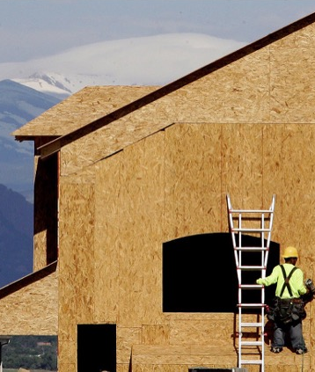
We Need More Homes
But land costs, building materials, and labor costs make it expensive to build new homes. Finding places to build them is hard, too.
Working together we can make it easier to create more homes—including more types of homes in the right places—at prices and rents people can afford.
People like young families, seniors, recent graduates, people with disabilities… all of us!
Notes:
This slide highlights some of the factors that make housing development so challenging. Keep the tone positive – we can overcome these challenges together and create homes at prices and rents people can afford.

Slide 7

We Are Partnering in New Ways
In the Denver region, local governments and other partners are working together to find ways to make it easier and less expensive to build new homes.
We collaborated to create a Regional Housing Strategy.
Led by the Denver Regional Council of Governments (DRCOG) with input from across the Front Range, it maps out ways to make sure our region has the homes we need now and into the future.
Notes:
Use this slide to share what the Regional Housing Strategy is and what its goals are. Ultimately, the strategy is about creating a better region with more housing options for everyone.

Slide 8
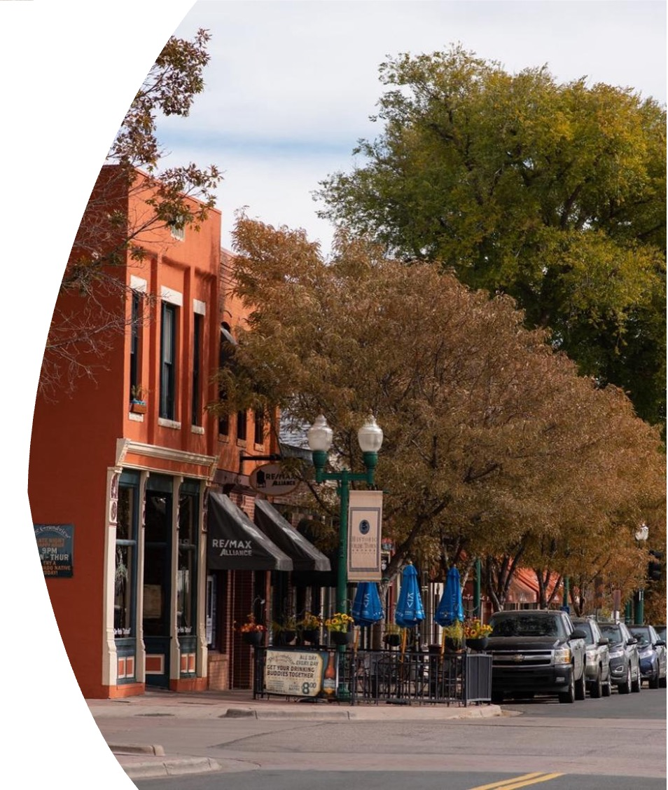
Regional Strategies,
Local Solutions
The Regional Housing Strategy points to ways in which communities across our region can create more housing choices.
What makes sense in one place doesn’t make sense everywhere. Each community must decide the solutions that work best for their needs.
When all of us do our part, we can create stronger communities—and a stronger region—with better housing choices for us all.
Notes:
This slide highlights that each community must choose the solutions that work best for its needs. There’s a role for all of us in creating a stronger region with better housing choices for all. Use this slide to showcase a particular need in your community and a potential or in-progress solution. Edit the slide to include a local photo or leave it as is.

Slide 9
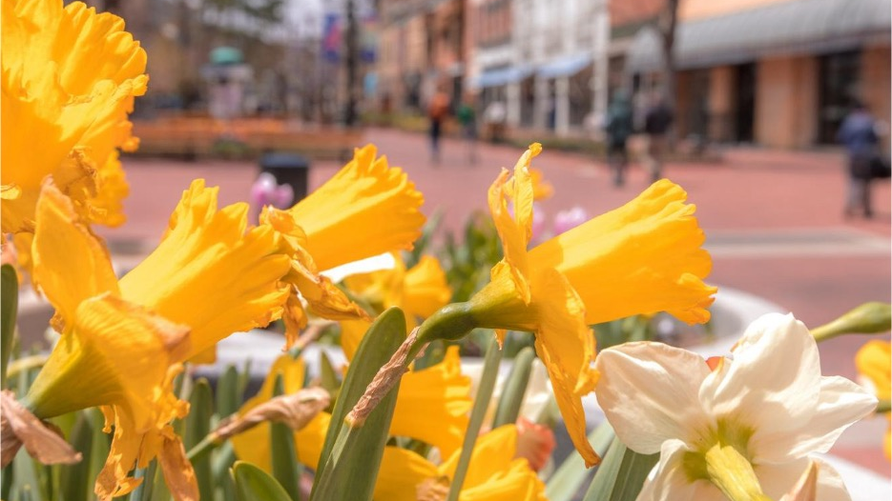
What Can We Do?
Notes:
This section highlights five ways in which communities can contribute to meeting the region’s housing needs, reflecting the five pathways of the Regional Housing Strategy (but using language that is more accessible to a general audience). Use this section to show that our housing crisis requires a comprehensive, multi-pronged approach.

Slide 10

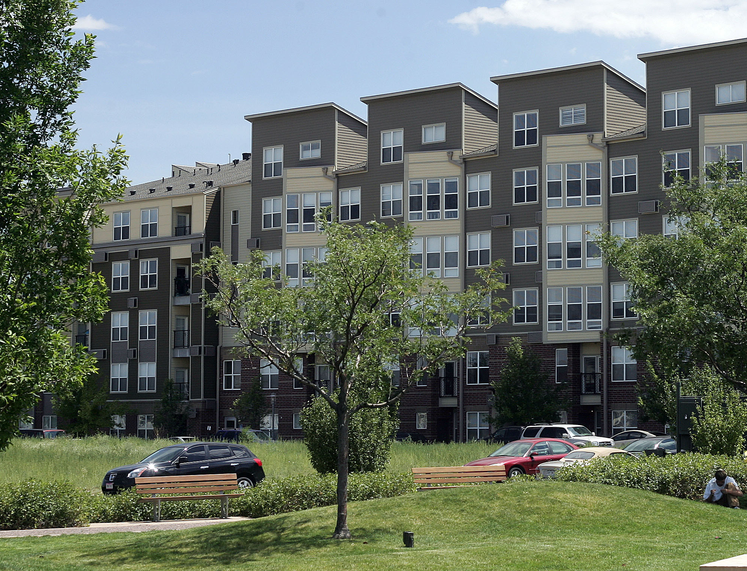
Make it easier and less expensive to build homes.
  Identify places where new homes of different types makes sense
  Provide clear and consistent rules for home building
  Make it faster to get new homes approved, especially affordable homes
  Look for ways to lower construction costs
Notes:
This slide outlines ways communities can make it easier and less expensive to build homes. Use this slide to explain ways in which your own community is reducing development costs and timelines to promote housing creation. Highlight any recent or planned initiatives to update zoning, streamline permitting, and reduce construction costs in your community.

Slide 11
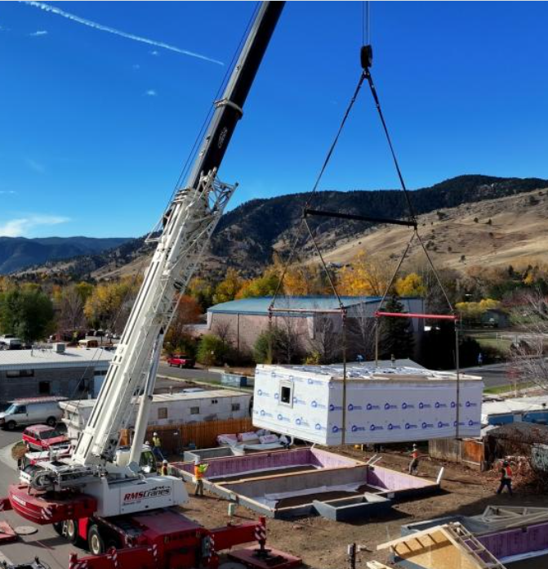
Lowering costs and growing workforce skills
Learning from our region
BoulderMOD is a modular factory dedicated specifically to delivering affordable homeownership for lower income families
The modular construction builds high-quality energy-efficent units at lower cost
Created through a partnership between the City of Boulder, Boulder Valley School District, and Flatirons Habitat for Humanity
Notes:
This slide highlights BoulderMOD, a regional example of lowering costs and growing workforce skills through modular housing. Use this slide to emphasize that communities around the region are thinking about ways to lower costs in innovative ways. Consider adding a local example or additional example you know of from other communities (in the region or elsewhere).
Learn more about BoulderMOD here.

Slide 12


Increase funding for housing.
  Work together to create new funding sources
  Improve coordination on housing investments
  Pool existing resources to maximize impact
  Provide access to shared technical expertise
Notes:
This slide highlights the ways in which communities can create new funding sources and maximize impact with existing resources. Use this slide to share recent or planned investments in funding for housing, for example, a local Affordable Housing Trust Fund or work you are doing with other jurisdictions or partners to fund new homes.

Slide 13

Investing in housing
Learning from our region
At least 7 DRCOG Member Governments currently have a local funding source dedicated to housing. Sources include:
  Sales tax dedicated to housing
  (Denver and Longmont)
  Property tax dedicated to housing (Boulder, Denver, and Longmont)
  Lodging tax dedicated to housing
  (Clear Creek County)
Notes:
This slide provides examples of jurisdictions in the Denver region that have created local funding sources for housing, showing different approaches to investment.

Slide 14

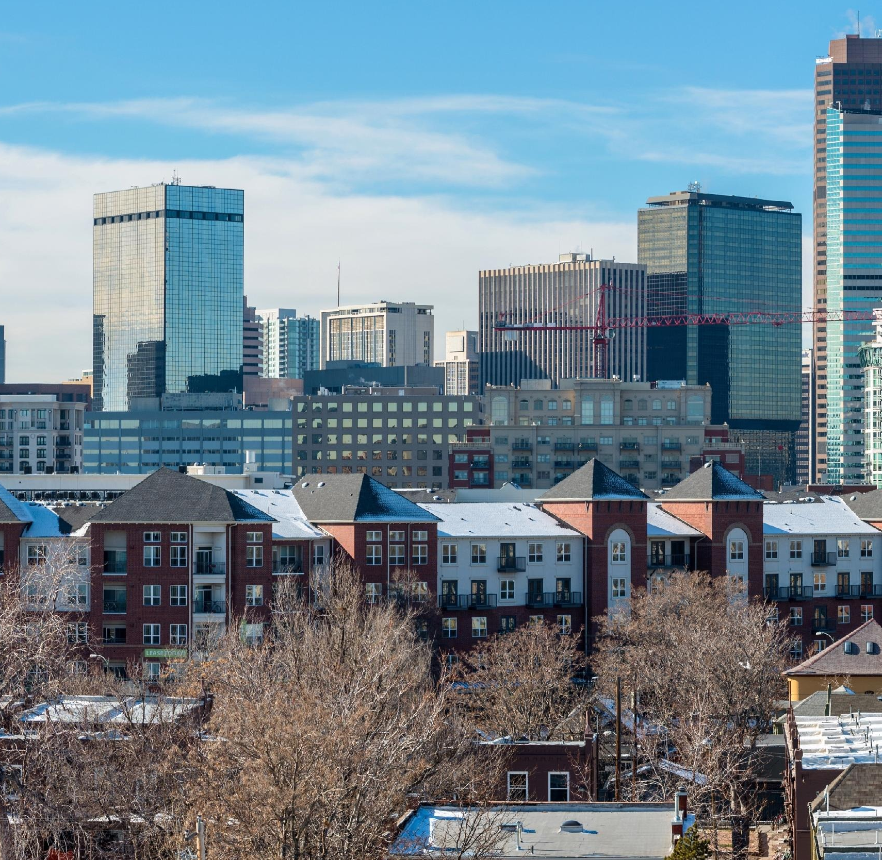
Create more choices and affordability.
  Coordinate transportation and housing investments to create vibrant neighborhoods with diverse housing options where people can walk, bike or ride to work, shopping, and school.
  Encourage new homes in places that have infrastructure in place.
  Make new and existing homes more efficient so that they need less energy and are less expensive to live in.
Notes:
This slide highlights the ways in which housing chooses can shape affordability, for example, by coordinating transportation and housing investments, thus reducing transit costs.

Slide 15
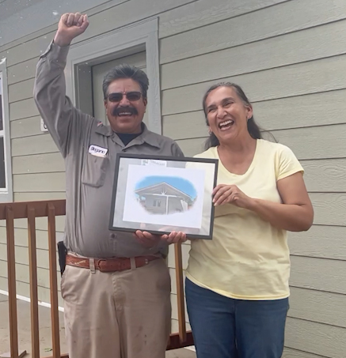
West Denver Single Family+
Learning from our region
  Helps homeowners add a second unit to their property, creating new homes in existing neighborhoods
  Provides pre-designed plans, financial assistance, and other support, helping residents generate rental income
  Created by the West Denver Renaissance Collaborative, a project of the Denver Housing Authority Planning & Data Department in partnership with mission-aligned funders
Notes:
This slide highlights West Denver Single Family+, a program that helps homeowners add second units to their properties, creating an income stream for the homeowner and adding new housing options in existing neighborhoods.
See more information on West Denver Single Family Plus here.

Slide 16

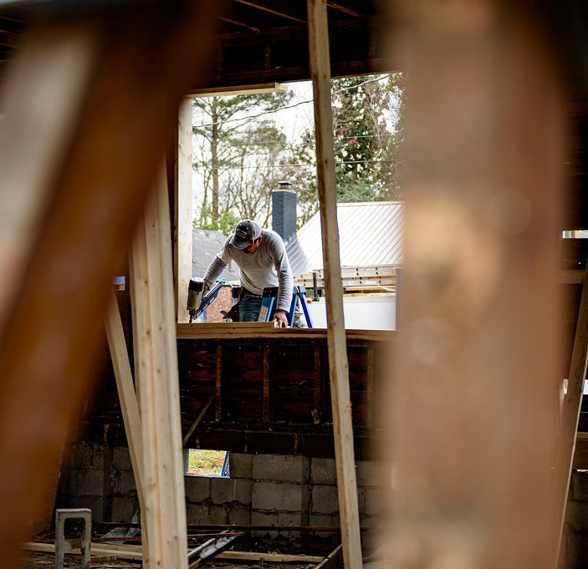
Help people stay in their communities.
  Rehabilitate older housing so that it lasts longer and stays affordable.
  Help tenants who are displaced by new development find new homes close by.
  Make sure that there is enough housing of all types and price points so that people can find what they need and can afford.
Notes:
Use this slide to highlight that preserving existing housing and protecting tenants are just as important as producing new housing. Communities can put in place funding sources to support the rehabilitation of older housing. And when tenants are displaced by new development, communities can ensure they have an affordable place to live close by.

Slide 17
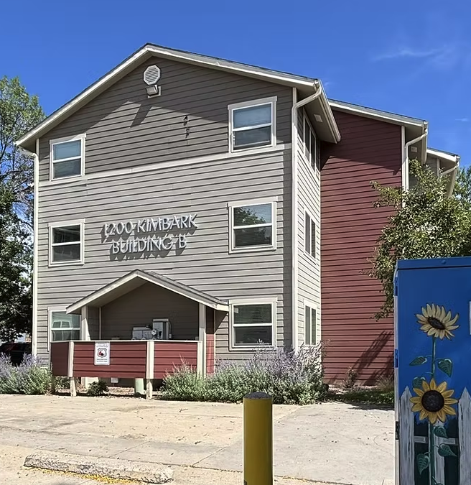
Community Land Trusts
Learning from our region
Land trusts are nonprofit groups that purchase properties to create and preserve affordable housing.
They can support rental or for-sale homes, preservation or new construction, and single family or multi-family homes.
Our region has land trusts that operate in specific neighborhoods, communities, and statewide.
Notes:
This slide highlights community land trusts, which community members may have varying levels of familiarity with. CLTs are one vehicle through which communities can rehabilitate older housing and preserve affordability. Highlight that they are non-profit groups that purchase properties to create or preserve affordable housing for rental or ownership housing. Share more details on any local community land trusts.

Slide 18


Support housing as a priority.
  Talk with friends and neighbors about why housing matters.
  Understand what will happen if we do not have enough homes of different types at prices people can afford.
  Make sure we are thinking about and planning for future generations.
  Get involved!
Notes:
Use this to highlight the role community members can play in supporting housing as a local priority. By getting more people involved in talking about why housing matters and identifying opportunities for new homes—of different types and at all levels of income—we can work locally and regionally to ensure everyone has access to affordable and quality housing that meets their needs.

Slide 19
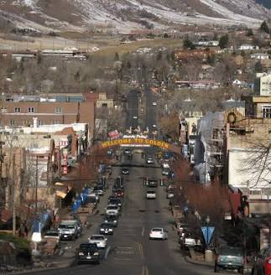
Jefferson County Partnerships
Learning from our region
  Partners in JeffCo are working together to create more housing.
  Partnership efforts include the Regional Housing Strategy, Jeffco Housing Blueprint, Jeffco Housing Steering Committee, and cross-jurisdictional funding and coordination for housing navigation.
  The Jeffco Advocacy Network is a coalition of residents who champion innovative, practical, and impactful solutions to community needs—including affordable housing.
Notes:
This slide shares the example of Jefferson County, which is actively partnering to create more housing. The Advocacy Network, a coalition of residents, is one example of a way that community members can engage more actively in housing issues. Change this slide or add another one that highlights local partnerships and ways in which you are working to build more support for housing.
See the JeffCo Housing Blueprint here.
Learn more about the Jeffco Advocacy Network here.

Slide 20

What Can Our Community Do?
We are part of a growing region.
What can our community do to:
Make it easier and less expensive to build housing?
Increase funding for housing?
Create more diverse housing choices in locations that to support more affordable living?
Preserve older housing and help current residents stay here?
Support housing as a community priority?
Notes:
Use this slide to engage participants in a discussion about how your local community can make it easier and less expensive to build housing, increase funding for housing, and advance other local housing priorities.
For more resources on talking about housing with your community, look at the Let’s Talk Housing Messaging Playbook and Why Housing Matters Slide Deck.

Slide 21


Learn More!
We can create the future we want by working together.
      Learn more about the
      Regional Housing Needs Assessment
      Learn more about the
      Regional Housing Strategy
      [Note to User: add other relevant links]
Notes:
If desired, you can use this slide to direct people to where they can learn more about the Regional Housing Needs Assessment, the Regional Housing Strategy, and other relevant efforts. Customize the slide with your contact information and additional links.
Visit the Regional Housing Strategy online.
Visit the Needs Assessment online.

Slide 22
Thanks for joining the conversation
Your voice matters in shaping solutions. Please stay involved!
Questions?
Contact [FILL IN LOCAL CONTACT]
Notes:
Thank participants for sharing their time and insights, and encourage them to stay involved in housing efforts. Customize this slide with your contact information.

